Slide 1
GLUTEAL REGION
BY
F.O. OPOOLA

Slide 2
INTRODUCTION
It lies posterior to the pelvis between the level of the iliac crest and inferior border of gluteus maximus muscle.
This region is made up of the gluteal muscles, ligaments, vessels (arteries & veins) and gluteal nerves.
The two buttocks formed mostly by the three most prominent gluteal muscles are separated from each other by the intergluteal cleft.
The inferior border is demarcated from the superior border of the thigh by the gluteal sulcus

Slide 3
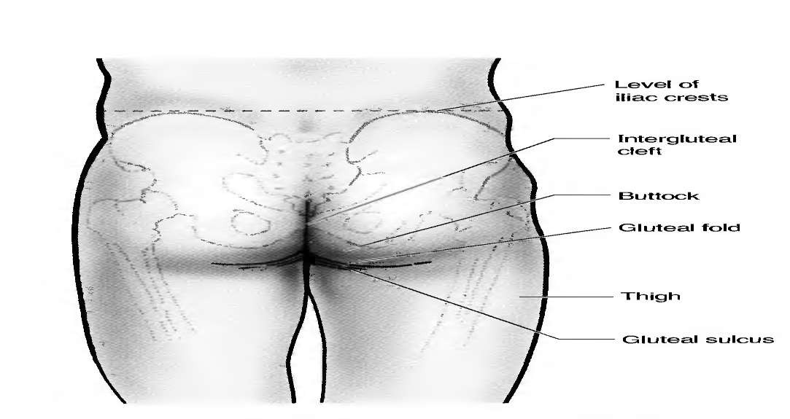
THE BUTTOCK

Slide 4
GLUTEAL LIGAMENTS
Two main ligaments make up the ligament components of the gluteal region and they include;
Sacrotuberous and sacrospinous ligaments.
These two ligaments converts the sciatic notch of the hip bone into a greater and lesser sciatic foramina.
The greater sciatic foramen forms a passageway through which structures entering and leaving the pelvis passes e.g. sciatic nerve.

Slide 5
GLUTEAL LIGAMENTS
The lesser foramen serves as a passageway for structures entering and leaving the perineum. E.g. pudendal nerve.
It is therefore worthy of note that the greater sciatic foramen can be likened to a ‘door’ through which all arteries and nerves leave the pelvis to enter the gluteal region, including the piriformis muscle which almost fill the foramen.

Slide 6
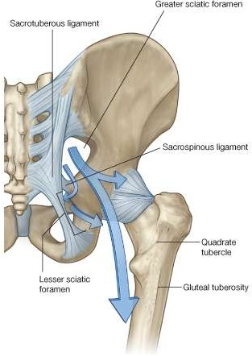
GLUTEAL LIG…

Slide 7
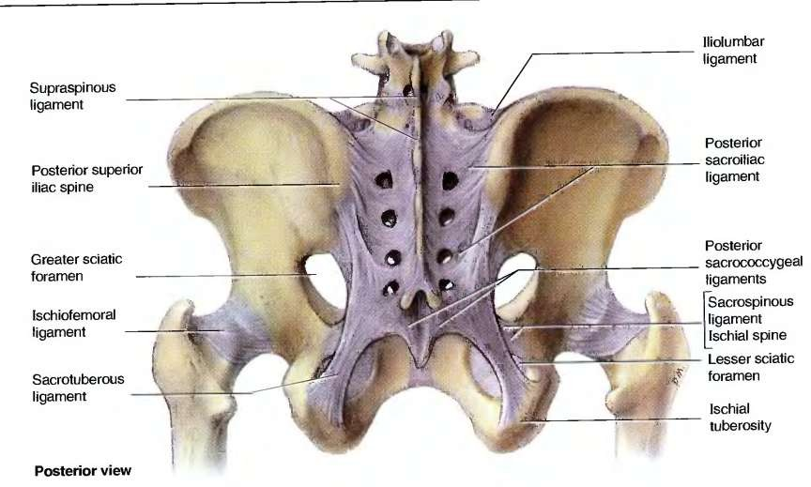
GLUTEAL LIG…

Slide 8
GLUTEAL MUSCLES
Muscles of the gluteal region are mainly in two groups:
a deep group of small muscles, which are mainly lateral rotators of the femur at the hip joint and include;
piriformis, obturator internus, gemellus superior, gemellus inferior, and quadratus femoris.

Slide 9
GLUTEAL MUSCLES
A more superficial group of larger muscles, which mainly abduct and extend the hip and include;
The gluteus minimus, gluteus medius, and gluteus maximus-an additional muscle in this group, the tensor fasciae latae.
The tensor fasciae latae stabilizes the knee in extension by acting on a specialized longitudinal band of deep fascia (the iliotibial tract) that passes down the lateral side of the thigh to attach to the proximal end of the tibia in the leg.

Slide 10
Superficial group
Gluteus maximus;
Is the largest muscle in the gluteal region and overlies most of the other gluteal muscles except for the posterior 3rd of the gluteus medius and also forms a pad over the ischial tuberosity.
origin/proximal attachment- ilium,posterior to the posterior gluteal line, posterior surface of the sacrum, coccyx and sacrotuberous ligament.

Slide 11
Superficial group
Insertion/distal attachment- iliotibial tract and gluteal tuberosity.
Innervation- innervation is by the inferior gluteal nerve with root values L5, S1-2.
Action- main action is extension and lateral rotation of the thigh.

Slide 12
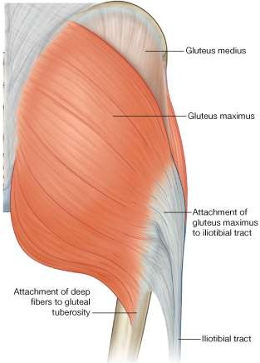
Superficial group

Slide 13
Superficial group
Gluteus medius and minimus ;
These are fan-shaped small gluteal muscles and their fibres passes the same direction.
Origin- medius originates from the external surface of the ilium between the anterior and posterior gluteal line, while the minimus originates from the external surface of the ilium between the anterior and inferior gluteal line.

Slide 14
Gluteus medius and minimus
Insertion- medius inserts on the lateral surface of greater trochanter while minimus inserts on anterior surface of greater trochanter of femur.
innervation- both by the superior gluteal nerve with root values L5 & S1.
Action- both medially rotates and abducts the lower limb at the hip joint.
Also keeps the pelvis at level when opposite leg is raised.

Slide 15
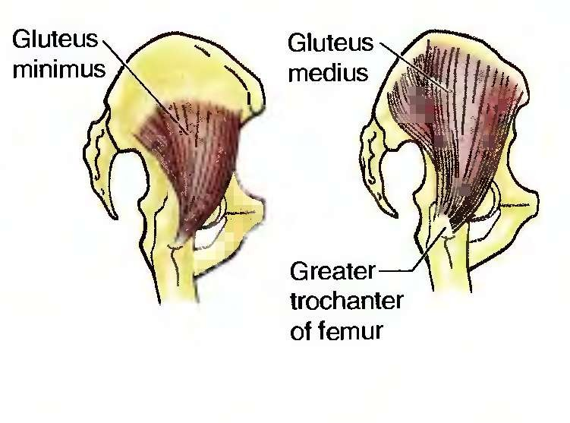

Slide 16
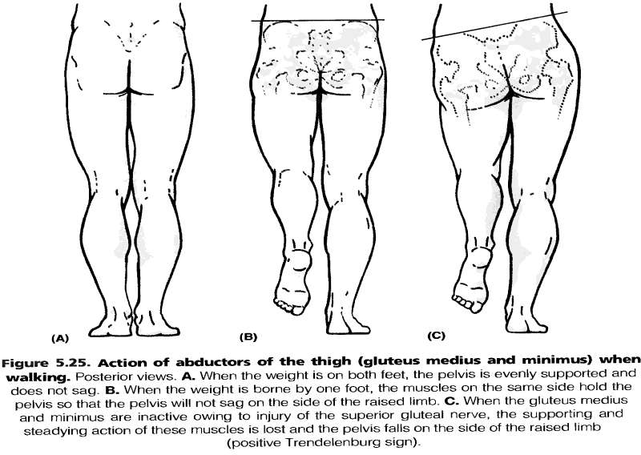
Actions of the G. medius & minimus

Slide 17
Tensor fasciae latae
Tensor fasciae latae;
The tensor fasciae latae muscle is the most anterior of the superficial group of muscles in the gluteal region and overlies the gluteus minimus and the anterior part of the gluteus medius.
Origin- Tensor fasciae latae originates from the outer margin of the iliac crest from the anterior superior iliac spine to approximately the tubercle of the crest.

Slide 18
Tensor fasciae latae
Insertion- anterior aspect of the iliotibial tract of deep fascia, which runs down the lateral side of the thigh.
Action- Stabilizes the knee in extension.
Working with the gluteus maximus muscle on the iliotibial tract lateral to the greater trochanter, Stabilizes the hip joint by holding the head of the femur in the acetabulum.
Innervation- superior gluteal nerve with root value L5 & S1.

Slide 19
Deep group of gluteal muscles
Piriformis;
A narrow pear-shaped muscle is the most superior of the deep group of gluteal muscles.
It is a muscle of the pelvic wall and of the gluteal region.
Origin- from the superior surface of the sacrum and the sacrotuberous ligaments

Slide 20
Deep group of gluteal muscles
Insertion- superior surface of the greater trochanter of femur.
Innervation- innervation is by the nerve to piriformis which are branches from ventra rami of S1 & S2.
Action- acts as a stabilizer of the head of the femur in the acetabulum and also extends rotated thigh laterally and abducts flexed thigh.

Slide 21
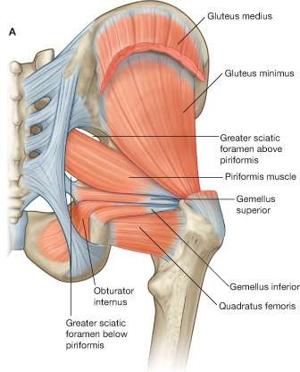
Piriformis (A)

Slide 22
Obturator internus, gamelli superior & inferior
These three fan-shaped muscles form a tricipital (3 heads).
Often called triceps coxae.
They occupy the space between the piriformis and the quadratus femoris muscle.

Slide 23
Obturator internus (B)

Slide 24
Obturator internus
Origin- pelvic surface of obturator membrane and surrounding bone.
Insertion- medial border of greater trochanter of femur.
Innervation- nerve to obturator internus with root value L5-S2.
Action- same as piriformis muscle.

Slide 25
Gemellus superior and inferior
(gemelli is Latin for twins) are a pair of triangular muscles associated with the upper and lower margins of the obturator internus tendon.
Origin- superior is from ischial spine, Inferior is from ischial tuberosity.

Slide 26
Gemellus superior and inferior
Insertion- its tendons blends with that of the obturator internus and inserts on the medial side of the greater trochanter of femur.
Innervation- superior gamelli is by nerve to obturator while inferior gamelliis by nerve to quadratus femoris.
Action- same as obturator internus and piriformis

Slide 27
Superior & inferior Gamelli (C)

Slide 28
Superior & inferior Gamelli (C)
Insertion- its tendons blends with that of the obturator internus and inserts on the medial side of the greater trochanter of femur.
Innervation- superior gamelli is by nerve to obturator while inferior gamelliis by nerve to quadratus femoris.
Action- same as obturator internus and piriformis

Slide 29
Quadratus femoris
quadratus femoris is a flat muscles ; it is the most inferior of the deep gluteal muscles. located below the gemelli and obturator internus.
originate : from the lateral aspect of the ischial tuberosity.
insertion: to the quadrate tuberosity on the intertrochanteric crest.
innervation : nerve to quadratus femoris
Action: lateral rotation of the lower limb

Slide 30
Nerves of gluteal region
Sciatic nerve
• L 4, 5; S 1, 2, 3
• Curves downward midway between the tuber ischii and the greater trochanter.
• Has a side of danger and a side of safety. Is the largest branch of the sacral plexus and the largest nerve in body
• Consists of two separate nerves, the common peroneal nerve and the tibial nerve • Leaves the pelvis through the greater sciatic foramen below the
Sciatic n.
Post. cut. n. of the thigh
Sup. glut. n.
Inf. glut. n.
Nerve to Quadratus femoris
Pudendal n.
Nerve to obturator internus

Slide 31
Intramuscular injections
From time to time it is necessary to administer drugs intramuscularly: that is, by direct injection into muscles.
This procedure must be carried out without injuring neurovascular structures.
A typical site for an intramuscular injection is the gluteal region.
The sciatic nerve passes through this region and needs to be avoided.
The safest place to inject is the upper outer quadrant of either gluteal region

Slide 32
Intramuscular injections
It is important to remember that the gluteal region extends as far forward as the anterior superior iliac spine.
The sciatic nerve curves through the upper lateral corner of the lower medial quadrant and descends along the medial margin of the lower lateral quadrant.
Occasionally, the sciatic nerve bifurcates into its tibial and common fibular branches in the pelvis, in which case the common fibular nerve passes into the gluteal region through, or even above, the piriformis muscle.

Slide 33
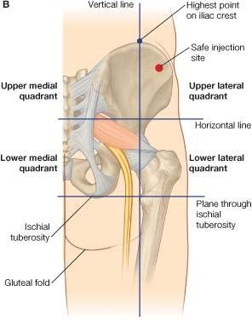
QUADRANT FOR INTERMUSCULAR INJECTION

Slide 34
GLUTEAL ARTERIES
Two arteries enter the gluteal region from the pelvic cavity through the greater sciatic foramen, the inferior gluteal artery and the superior gluteal artery.
They supply structures in the gluteal region and posterior thigh and have important collateral anastomoses with branches of the femoral artery.

Slide 35
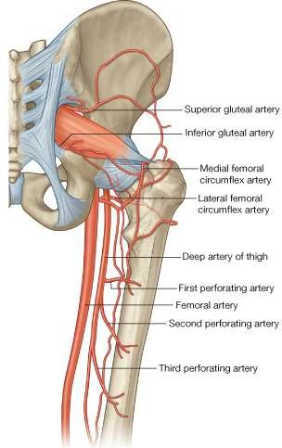
GLUTEAL ARTERIES

